Slide 1

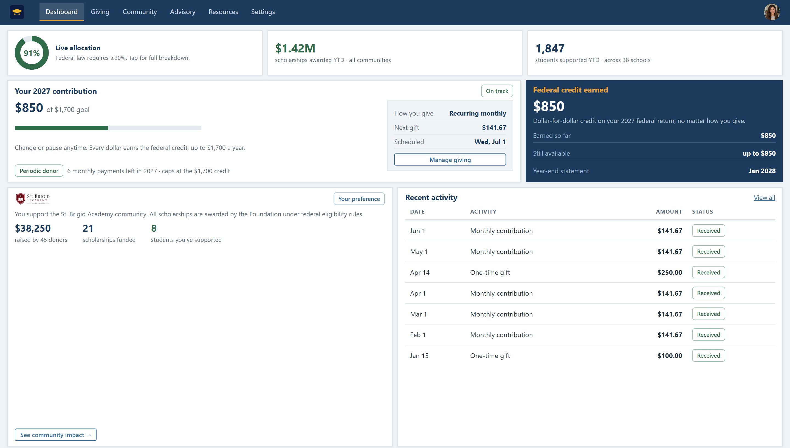
How it works
Four moving parts, all handled for you.
1
We share the information
Ready-to-share materials that answer your community’s questions.
2
Your community contributes
Supporters sign up online and choose the school they support.
3
A simple system tracks it all
Easy to track, with full transparency: receipts, statements, live reporting.
4
Scholarships reach your students
The Foundation awards under federal rules; at least 90% becomes scholarships.
The live giving dashboard: every gift tracked, with full transparency
K-12 Scholarship Foundation, Inc.
K-12 Scholarship Foundation · Sources: irs.gov · ed.gov · treasury.gov
6

Slide 2
No net cost to donors
Each contribution can be offset by the federal tax credit.
−$1,700
+$1,700
$0
+
=
donated to scholarships
for your school community
federal tax credit:
taxes owed go down dollar-for-dollar
net cost to the donor,
every single year
For employees, it’s even simpler: a small payroll contribution (about $65 per biweekly paycheck) pairs with a matching withholding adjustment, so take-home pay stays the same all year.
Credit is nonrefundable; donors need at least $1,700 in federal tax liability to use it fully in one year; unused amounts carry forward up to 5 years. Simplified overview, not tax advice: please review your situation with your accountant or tax professional (irs.gov).
K-12 Scholarship Foundation, Inc.
K-12 Scholarship Foundation · Sources: irs.gov · ed.gov · treasury.gov
7

Slide 3
Beyond tuition
Scholarships follow the federal expense definition. Every school type benefits.
PRIVATE & RELIGIOUS SCHOOL STUDENTS
Tuition and fees: scholarships designed to cover up to the full cost, depending on funds raised, paid directly to the school.
Who qualifies? Most families.
✓
Household income up to 300% of the area median; the large majority of families
✓
Student eligible to enroll in public K-12 school (current school doesn’t matter)
PUBLIC & CHARTER SCHOOL STUDENTS
Tutoring · technology · books & supplies · transportation · special-needs services · class trips · equipment, as confirmed by the joint U.S. Education & Treasury fact sheet.
✓
Scholarship money is not taxable income to the family
✓
Renewing students and siblings get priority by federal law
K-12 Scholarship Foundation, Inc.
K-12 Scholarship Foundation · Sources: irs.gov · ed.gov · treasury.gov
8

Slide 4
What could your community raise?
A simple, conservative example: 10% participation.
400
≈ 220
+ 50
= 270
students
parent households
teachers & staff
potential donors
If just 10% participate (27 donors × $1,700):
$45,900 per year
at 25% participation: $114,750 / year · over five years at 10%: $229,500
Estimates assume $1,700 per participating donor and ~1.8 children per family; actual results depend on participation and eligibility.
K-12 Scholarship Foundation, Inc.
K-12 Scholarship Foundation · Sources: irs.gov · ed.gov · treasury.gov
9

Slide 5
K-12
Let’s get your community ready.
A 20-minute conversation is all it takes to see what this could mean for your school.
1
2
3
Schedule a time to learn more
We map your community’s potential
Your school is ready for day one
k12scholarshipfoundation.org · Schedule a time to learn more
The K-12 Scholarship Foundation, Inc. · Federal tax-exempt status application pending; SGO listing occurs through participating states.
Program begins January 1, 2027. This overview simplifies the program and is not tax advice; please review your plans with your accountant or tax professional and the sources here. Sources: irs.gov · ed.gov · treasury.gov
K-12 Scholarship Foundation, Inc.

